Slide 1
Routing in Unidirectional (n, k)-Star Graphs
Eddie Cheng and Serge Kruk
Department of Mathematics and Statistics, Oakland University
Presenter: Chiao-Wei Chiu
Date: Jan. 16, 2008

Slide 2
Abstract
The class of (n, k)-star graphs and their unidirectional version were introduced as generalizations of star graphs and unidirectional star graphs respectively. In this paper, we substantially improved previously known bound for the diameter of unidirectional (n, k)-star graphs.
The previous bound was 10k-5 for small k and 5k+5[(n-1)/2] for large k; the new bound is 7(k-3)+18. In addition, a distributing routing algorithm is presented, analyzed theoretically for worst-case behavior and exercised experimentally for average case behavior.

Slide 3
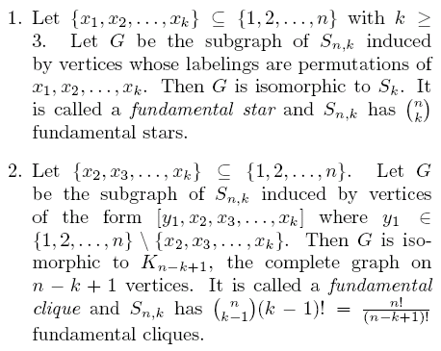
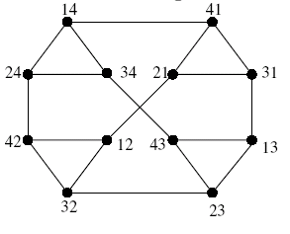
Classes of subgraphs
S_{4,2}

Slide 4
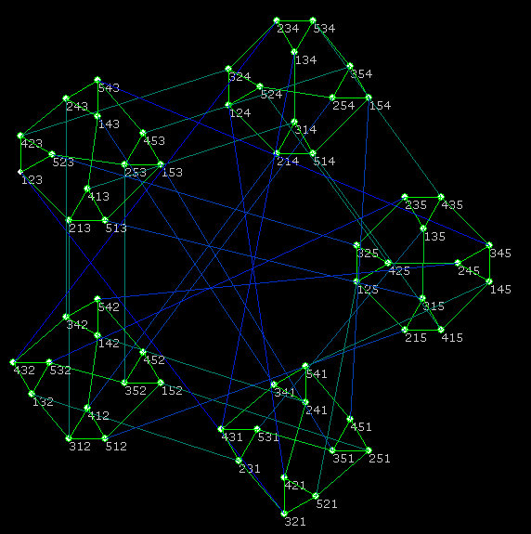
S_{5,3}

Slide 5
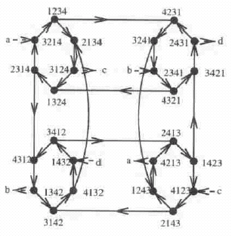
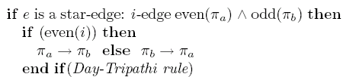
Unidirectional star
US₄

Slide 6
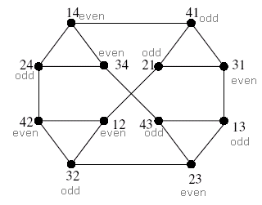
Associated permutation
12 = 1234
32 = 3214 - 1234
23 = 2314 - 3214 - 1234
41 = 4123 - 3124 - 2134 - 1234

Slide 7
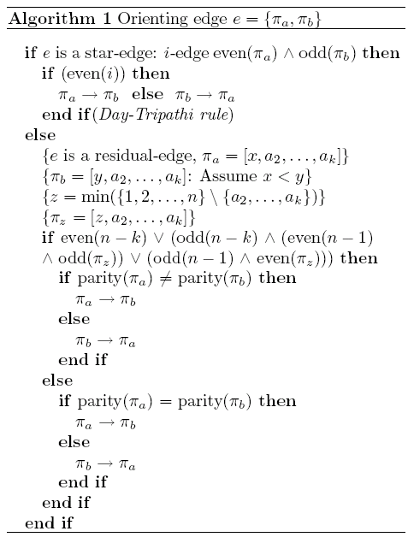
Directed (n, k)-stars
A vertex is called i-good
if the unique i-edge is directed
away from this vertex where i ≧ 2

Slide 8
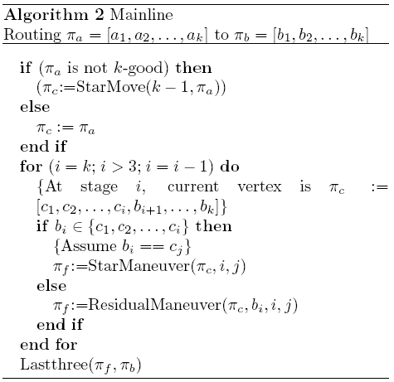
Routing
:32745
62745
:52746
72546
:42576
52476
12476
42176
:24176
Residual
Star
Last 3

Slide 9
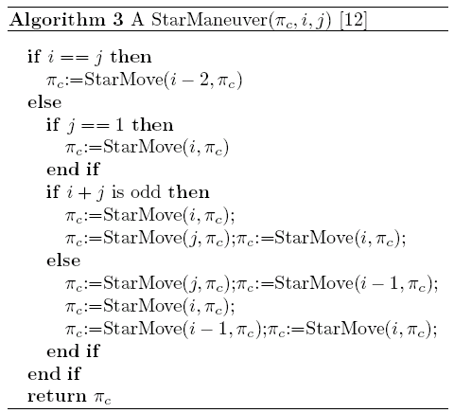
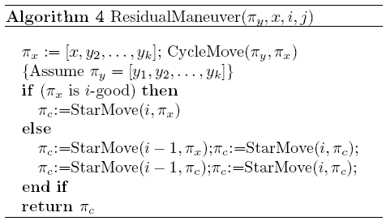
Functions

Slide 10
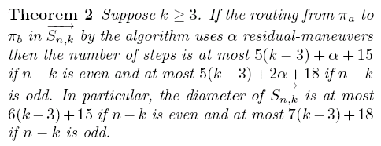
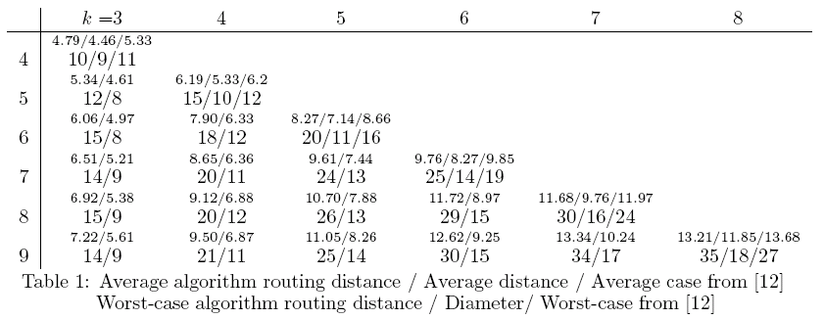
Diameter

